Slide 1
Database System
Lecture 10: Query Processing
陈 刚
College of Computer Science
Zhejiang University
18667106736 / cg@zju.edu.cn

Slide 2
Three Points
CPU can’t manipulate the data in disk directly.
The growth rate of the disk data read/write (transer) speed is much slower than that of the disk size.
  In 20 years, disk size: 1000 times; read/write speed: 40 times
The growth rate of the disk seek speed is much slower than that of the disk data transfer speed.
Lecture 10: Query Processing — Database System

Slide 3
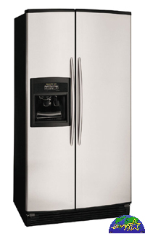
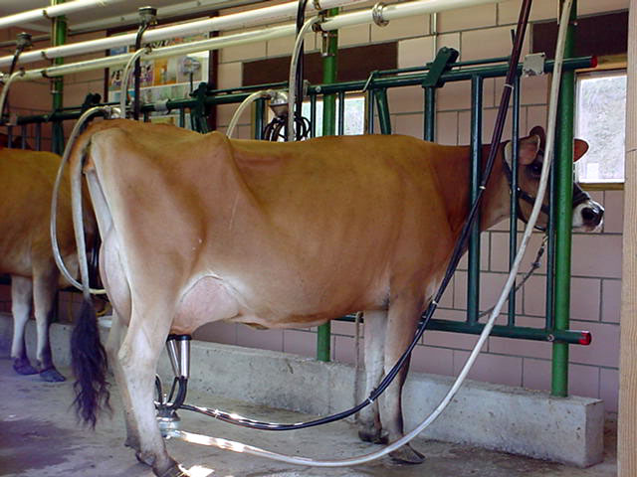


Model of Memory Hierarchy
SRAM
DRAM
DISK
Reg
File
L1
Data cache
L2
Cache
Main
Memory
L1
Inst cache

Slide 4
Levels of the Memory Hierarchy
Deeper levels of cache memory
Large memories are slow, fast memories are small and expensive.
Tertiary
storage
(Disk/Tape)
processor
Secondary
storage
(Disk)
Main
memory
(DRAM)
control
Second
level
cache
(SRAM)
datapath
On chip
Cache
Registers
Speed (ns): 1-5 ns
Size (bytes): 32KB
5 – 25 ns
1-2MB
80 - 250ns
1-8GB
~10 ms
20-200GB
~ 10 sec
TB

Slide 5

Outline
Overview
Measures of Query Cost
Selection Operation
*Sorting
Join Operation
*Other Operations
*Evaluation of Expressions
Lecture 10: Query Processing — Database System

Slide 6

Basic Steps in Query Processing
1. Parsing and translation
2. Optimization
3. Evaluation
Lecture 10: Query Processing — Database System

Slide 7
Basic Steps in Query Processing (Cont.)
Parsing and translation (语法分析与翻译) vs. compiler
  Parser checks syntax, verifies relations
  Translate the query into its internal form--- extended relational algebra (ERA).
Evaluation
  The query-execution engine takes a query-evaluation plan, executes that plan, and returns the answers to the query.
An evaluation plan defines exactly what algorithm is used for each operation, and how the execution of the operations is coordinated.
parser
SQL programs
Parser-tree
Internal form--ERA
Lecture 10: Query Processing — Database System

Slide 8
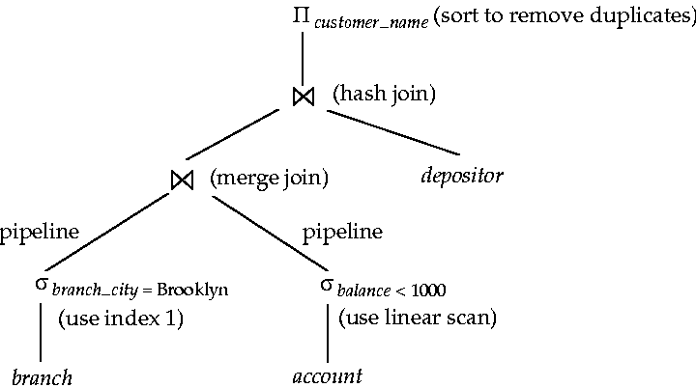
An evaluation plan defines exactly what algorithm is used for each operation, and how the execution of the operations is coordinated.

Slide 9
Basic Steps in Query Processing (Cont.)
Optimization ------- why ?
  (1) For a given SQL query, may have many equivalent relational algebra expressions .
    E.g.: Select balance from account where balance > 2500;
  (a) σ_{balance>2500}(∏_{balance}(account))
  (b) ∏_{balance}(σ_{balance>2500}(account))
  (2) Each relational algebra operation can be evaluated using one of several different algorithms.
    E.g., For above (b), how to do the σ operation, use linear scan, or index ?
  Correspondingly, a relational-algebra expression can be evaluated in many ways.
  Annotated expression specifying detailed evaluation strategy is called an evaluation-plan.
Lecture 10: Query Processing — Database System

Slide 10
Basic Steps: Optimization(Cont.)
(1) Find out various equivalent relational algebra expressions. (chp. 14)
(2) A sequence of primitive operations which specify detailed evaluation strategy is called a query-execution plan or query evaluation-plan.
E.g1:
(1) use an index on balance to find accounts with balance > 2500
∏_{balance}
︱
σ_{balance>2500,} using index 1
︱
account
query-execution plan
Lecture 10: Query Processing — Database System

Slide 11
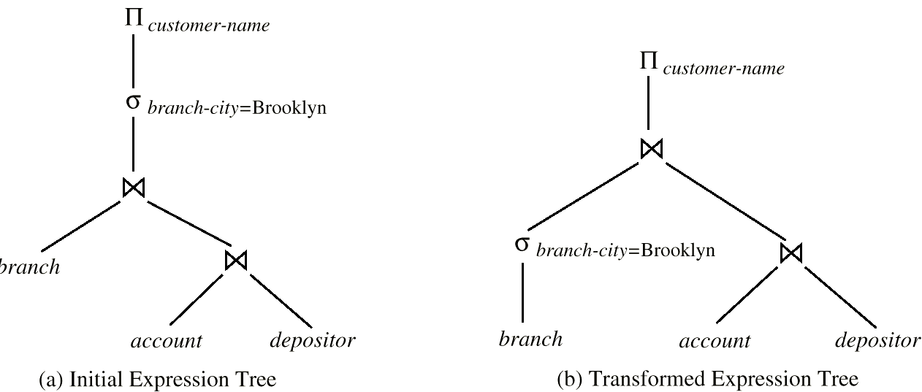
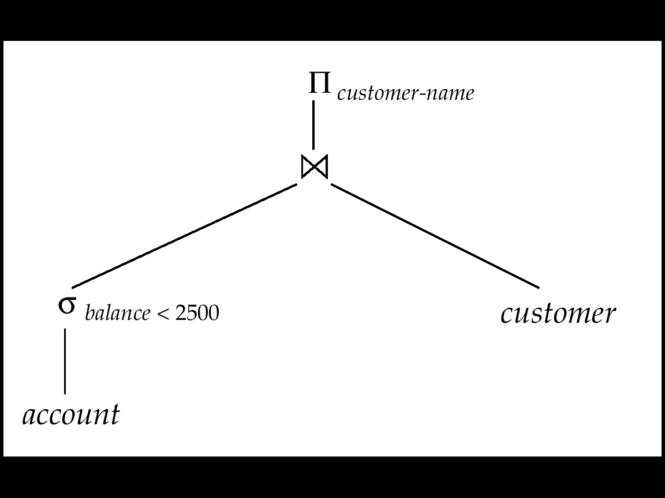
E.g2:
∏_{customer-name} ( σ_{branch-city=‘Brooklyn} ( branch account depositor )
Some equivalent relational algebra expressions
(Partial query-execution plan)
Lecture 10: Query Processing — Database System

Slide 12
Basic Steps: Optimization (Cont.)
(3) Query Optimization: Among all equivalent evaluation plans choose the one with lowest cost. Two factors are considered for cost:
  Cost is dependent on the algorithms of the executions.
  Cost is also estimated using statistical information from the database catalog.
    E.g., the number of tuples in each relation, the size of tuples, etc.
In this chapter we study
  How to measure query costs:
    Algorithms for evaluating relational algebra operations: select, join
    How to combine algorithms for individual operations in order to evaluate a complete expression
In Chapter 14
  We study how to optimize queries, that is, how to find an evaluation plan with lowest estimated cost
Lecture 10: Query Processing — Database System

Slide 13
Outline
Overview
Measures of Query Cost
Selection Operation
*Sorting
Join Operation
*Other Operations
*Evaluation of Expressions
Lecture 10: Query Processing — Database System

Slide 14
Measures of Query Cost
Cost is generally measured as total elapsed time for answering query.
  Many factors contributes to time cost
    Disk access + CPU + network communication
Typically disk access is the predominant cost, and is relatively easy to estimate. Measured by taking into account:
  Number of seek operations performed
  Number of blocks read × average-block-read-cost
  Number of blocks written × average-block-write-cost
    Cost to write a block is greater than cost to read a block
      Data is read back after being written to ensure that the write was successful
Lecture 10: Query Processing — Database System

Slide 15
Measures of Query Cost (Cont.)
For simplicity, we just use the number of block transfers from disk and the number of seeks as the cost measures:
  t_{T} – time to transfer one block. (≈ 0.1ms)
  t_{S} – time for one seek. (≈ 4ms)
  Cost for b block transfers plus S seeks
  b * t_{T} + S * t_{S}
We ignore CPU costs for simplicity.
  But real systems do take CPU cost into account
We do not include cost to writing the final result back to disk in our cost formulae.
Lecture 10: Query Processing — Database System

Slide 16
Measures of Query Cost (Cont.)
Costs depends on the size of the buffer in main memory
  Having more memory, reduces need for disk access
  Amount of real memory available to buffer depends on other concurrent OS processes, and hard to determine ahead of actual execution
  We often use worst case estimates, assuming only the minimum amount of memory needed for the operation is available, and the best case estimates.
  Required data may be buffer resident already, avoiding disk I/O. But hard to take into account for cost estimation
Lecture 10: Query Processing — Database System

Slide 17
Outline
Overview
Measures of Query Cost
Selection Operation
*Sorting
Join Operation
*Other Operations
*Evaluation of Expressions
Lecture 10: Query Processing — Database System

Slide 18
Selection Operation: (1) Basic algorithms
File scan – search algorithms that locate and retrieve records that fulfill a selection condition, do not use index.
Algorithm A1 (linear search). Scan each file block and test all records to see whether they satisfy the selection condition.
  Cost estimate = b_{r} block transfers + 1 seek
    b_{r} denotes number of blocks containing records from relation r
  If selection is on a key attribute, can stop on finding record
    cost = (b_{r} /2) block transfers + 1 seek
  Linear search can be applied regardless of
    selection condition or
    ordering of records in the file, or
    availability of indices
Note: binary search generally does not make sense since data is not stored consecutively
  Except when there is an index available,
  And binary search requires more seeks than index search
Lecture 10: Query Processing — Database System

Slide 19
Basic algorithms
A2 (binary search). Applicable if selection is an equality comparison on the attribute on which file is ordered.
  Assume that the blocks of a relation are stored contiguously
  Cost = ⎡log₂(b_{r} )⎤block transfer + ⎡log₂(b_{r} )⎤ seek –cost of locating the first tuple by a binary search on the blocks.
  (time cost = ⎡log₂(b_{r} )⎤ * (t_{S} + t_{T}))
  If selection is not on a key attribute, need plus the number of blocks containing records that satisfy selection condition.
  block transfer = ⎡log₂(b_{r} )⎤ + ⎡sc(A, r) / f_{r}⎤ - 1, 其中sc(A, r) 是满足选则条件的记录数，f_{r} 是每个block的记录数 (See chpt14)
Lecture 10: Query Processing — Database System

Slide 20
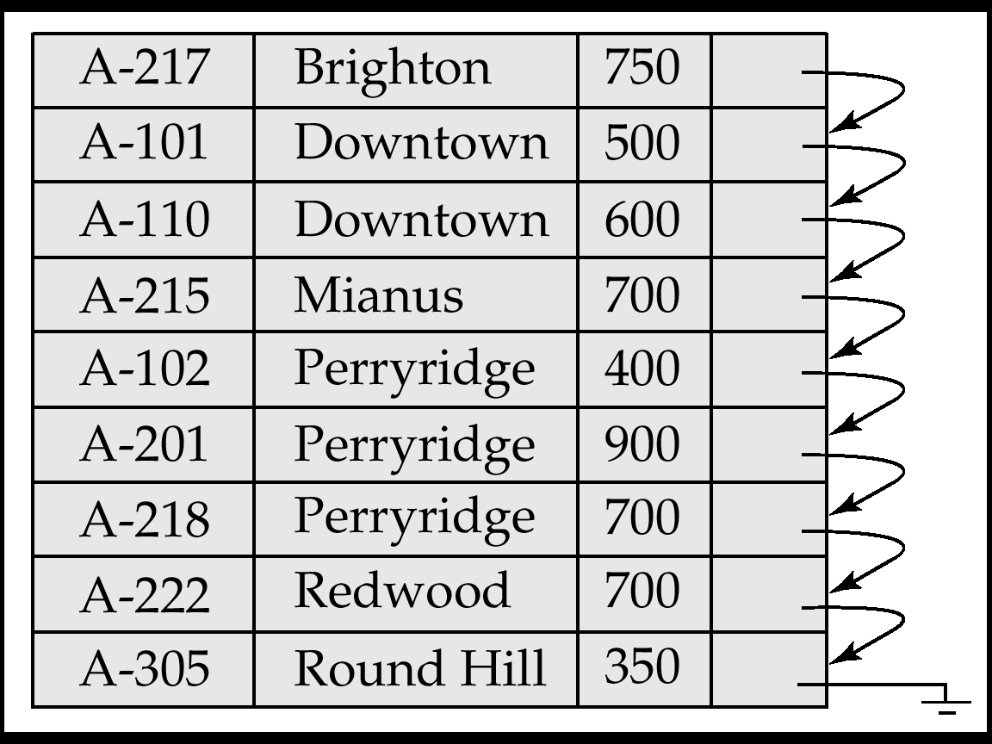
account(account_number, branch_name, balance)
Assume: account is sequentially ordered on search-key branch_name.
Select * from account where branch_name = ‘Downtown’;
May return 100 tuples.
Lecture 10: Query Processing — Database System

Slide 21
(2) Selections Using Indices and equality
Index scan – search algorithms that use an index
  Selection condition must be on search-key of index.
A3 (primary index, equality on key). Retrieve a single record that satisfies the corresponding equality condition
  Cost = (h_{i} + 1) * (t_{T} + t_{S})，其中 h_{i} 为索引树高
A4 (primary index, equality on nonkey) Retrieve multiple records.
  Records will be on consecutive blocks
    Let b = number of blocks containing matching records
  Cost = h_{i} * (t_{T} + t_{S}) + t_{S} + t_{T} * b, b containing retrieved records
= ⎡sc(A, r) / f_{r}⎤
Lecture 10: Query Processing — Database System

Slide 22

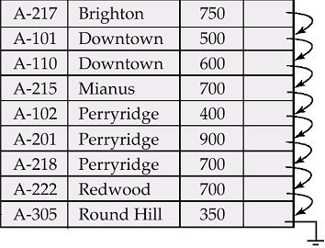
B⁺-tree for account file (n = 3)
索引集
B⁺树索引
顺序集
数据文件
Lecture 10: Query Processing — Database System

Slide 23
Selections Using Indices
A5 (secondary index, equality on nonkey).
  Retrieve a single record if the search-key is a candidate key
    Cost = (h_{i} + 1) * (t_{T} + t_{S})
  Retrieve multiple records if search-key is not a candidate key
    Each of n matching records may be on a different block
    Cost = (h_{i} + n) * (t_{T} + t_{S})
      Can be very expensive!
      May be more worse than linear scan.
Lecture 10: Query Processing — Database System

Slide 24
(3) Selections Involving Comparisons
比较符：>, >=, <, <=, <>, 与等值比较的不同之处在于选择范围大
Can implement selections of the form σ_{A≤V} (r) or σ_{A ≥ V} (r) , by using：
  a) A linear file scan;
  b) Binary search (as A2);
  c) Using indices in the following ways:
A6 (primary index, comparison, 基于主索引的比较).
  For σ_{A ≥ V}(r), use index to find the first tuple A ≥ v and scan relation sequentially from there.
  For σ_{A≤V} (r), just scan relation sequentially till first tuple A>v; do not use index
A7 (secondary index, comparison, 基于辅助索引的比较)
  For σ_{A ≥ V}(r), use index to find first index entry ≥ v and scan index sequentially from there, to find pointers to records.
  For σ_{A≤V} (r), just scan leaf pages of index finding pointers to records, till first entry A > v is meet
  In either case, retrieve records that are pointed to
    Requires an I/O for each record
    Linear file scan may be cheaper
Lecture 10: Query Processing — Database System

Slide 25
(4) Implementation of Complex Selections
Conjunction: σ_{θ1} ∧ _{θ2}∧ . . . _{θn}(r)
A8 (conjunctive selection using one index).
  Select a combination of θ_{I}, and algorithms A1 through A7 that results in the least cost for σ_{θi} (r). (第一步从n个条件θ₁ … θ_{n}中选择代价最小的θ_{i}先执行，返回元组放内存，然后第二步对这些元组施行其他θ_{i}.）
  Test other conditions on tuple after fetching it into memory buffer.
A9 (conjunctive selection using composite index).
  Use appropriate composite (multiple-key) index if available.
A10 (conjunctive selection by intersection of identifiers).
  Requires indices with record pointers.
  Use corresponding index for each condition, and take intersection of all the obtained sets of record pointers.
  Then fetch records from file
  If some conditions do not have appropriate indices, apply test in memory.
Lecture 10: Query Processing — Database System

Slide 26
Algorithms for Complex Selections
Disjunction: σ_{θ1} ∨ _{θ2} ∨ . . . _{θn} (r).
A10 (disjunctive selection by union of identifiers).
  Applicable if all conditions have available indices.
    Otherwise use linear scan.
  Use corresponding index for each condition, and take union of all the obtained sets of record pointers.
  Then fetch records from file
Negation: σ_{¬θ}(r)
  Use linear scan on file
  If very few records satisfy ¬θ, and an index is applicable to θ
    Find satisfying records using index and fetch from file
Lecture 10: Query Processing — Database System

Slide 27
Outline
Overview
Measures of Query Cost
Selection Operation
*Sorting
Join Operation
*Other Operations
*Evaluation of Expressions
Lecture 10: Query Processing — Database System

Slide 28
*Sorting
Why: two cases for sorting of data:
  Output request
  Join operations can be implemented quickly.
We may build an index on the relation, and then use the index to read the relation in sorted order. But this is only logically, not physically ordered the relation, and may lead to one disk block access for each tuple.
How:
  For relations that fit in memory, techniques like quicksort can be used for sorting.
  For relations that don’t fit in memory, external sort-merge (外部排序归并) is a good choice.
Lecture 10: Query Processing — Database System

Slide 29
External Sort-Merge
Let M denote memory size (in pages).
Create sorted runs. Let i be 0 initially.
Repeatedly do the following till the end of the relation:
(a) Read M blocks of relation into memory
(b) Sort the in-memory blocks
(c) Write sorted data to run R_{i}; increment i.
Let the final value of i be N
Merge the runs (next slide) …..
Lecture 10: Query Processing — Database System

Slide 30
External Sort-Merge (Cont.)
Merge the runs (N-way merge). We assume (for now) that N < M.
  Use N blocks of memory to buffer input runs, and 1 block to buffer output. Read the first block of each run into its buffer page
  Repeat
    Select the first record (in sort order) among all buffer pages
    Write the record to the output buffer. If the output buffer is full write it to disk.
    Delete the record from its input buffer page.
    If the buffer page becomes empty then
    read the next block (if any) of the run into the buffer.
  Until all input buffer pages are empty:
Lecture 10: Query Processing — Database System

Slide 31
External Sort-Merge (Cont.)
If N ≥ M, several merge passes are required.
  In each pass, contiguous groups of M - 1 runs are merged.
  A pass reduces the number of runs by a factor of M -1, and creates runs longer by the same factor.
    E.g., If M = 11, and there are 90 runs, one pass reduces the number of runs to 9, each 10 times the size of the initial runs
  Repeated passes are performed till all runs have been merged into one.
Lecture 10: Query Processing — Database System

Slide 32
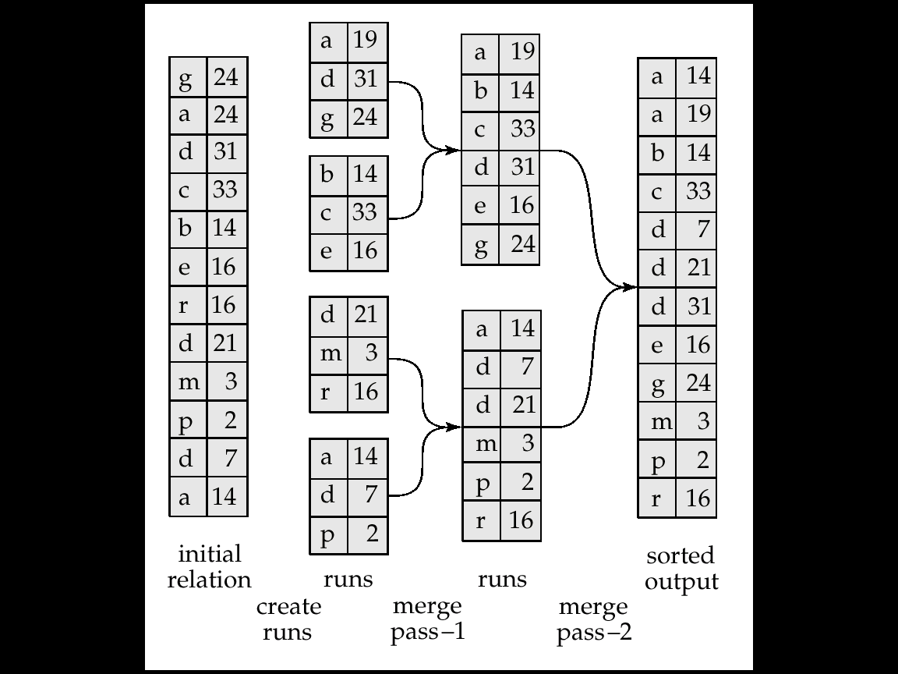
Example: External Sorting Using Sort-Merge
Pass 1
Pass 0
Pass 1
Pass 2
Assume: M = 3
one block for 1 tuple
R1
R21
R21
19
R2
R31
算法思路类似于体育比赛：
小组赛→大组赛→决赛
R3
R22
R22
R4
Sort key
Run files(归并段)
N₀=b/M
N₂=N₁/(M-1)
= 1
N₁= N₀/(M-1)
Lecture 10: Query Processing — Database System

Slide 33
External Merge Sort (Cont.)
Cost analysis:
  Total number of merge passes required: ⎡log_{M–1}(b_{r}/M)⎤.
  Block transfers for initial run creation as well as in each pass is 2b_{r}
    For final pass, we don’t count write cost
      We ignore final write cost for all operations since the output of an operation may be sent to the parent operation without being written to disk
    Thus total number of block transfers for external sorting:
    b_{r} ( 2 ⎡log_{M–1}(b_{r} / M)⎤ + 1)
  Seeks: next slide
Lecture 10: Query Processing — Database System

Slide 34
External Merge Sort (Cont.)
Cost of seeks
  During run generation: one seek to read each run and one seek to write each run
    2 ⎡b_{r} / M⎤
  During the merge phase
    Buffer size: b_{b} (read/write b_{b} blocks at a time)
    Need 2 ⎡b_{r} / b_{b}⎤ seeks for each merge pass
      except the final one which does not require a write
    Total number of seeks:
    2 ⎡b_{r} / M⎤ + ⎡b_{r} / b_{b}⎤ (2 ⎡log_{M–1}(b_{r} / M)⎤ -1)
Lecture 10: Query Processing — Database System

Slide 35
Outline
Overview
Measures of Query Cost
Selection Operation
*Sorting
Join Operation
*Other Operations
*Evaluation of Expressions
Lecture 10: Query Processing — Database System

Slide 36
Join Operation
depositor
customer
Several different algorithms to implement joins
  Nested-loop join
  Block nested-loop join
  Indexed nested-loop join
  Merge-join
  Hash-join
Examples use the following information
  Num of records of customer:n = 10,000, depositor:n = 5000
  Num of blocks of customer:b = 400 , depositor:b = 100
Lecture 10: Query Processing — Database System

Slide 37
Nested-Loop Join
To compute the theta join r _{θ} s
for each tuple t_{r} in r do begin
for each tuple t_{s} in s do begin
test pair (t_{r},t_{s}) to see if they satisfy the join condition θ
if they do, add t_{r} • t_{s} to the result.
end
end
r is called the outer relation and s the inner relation of the join.
Requires no indices and can be used with any kind of join condition.
Expensive since it examines every pair of tuples in the two relations.

Slide 38
Nested-Loop Join (Cont.)
In the worst case, if there is enough memory only to hold one block of each relation, the estimated cost is
n_{r} ∗ b_{s} + b_{r} block transfers, plus
n_{r} + b_{r} seeks
If the smaller relation fits entirely in memory, use that as the inner relation.
  Reduces cost to b_{r} + b_{s} block transfers and 2 seeks
Assuming worst case memory availability cost estimate is
  with student as outer relation:
    5000 ∗ 400 + 100 = 2,000,100 block transfers,
    5000 + 100 = 5100 seeks
  with takes as the outer relation
    10000 ∗ 100 + 400 = 1,000,400 block transfers and 10,400 seeks
If smaller relation (student) fits entirely in memory, the cost estimate will be 500 block transfers.
Block nested-loops algorithm (next slide) is preferable.

Slide 39
Block Nested-Loop Join
Variant of nested-loop join in which every block of inner relation is paired with every block of outer relation.
for each block B_{r} of r do begin
for each block B_{s} of s do begin
for each tuple t_{r} in B_{r} do begin
for each tuple t_{s} in B_{s} do begin
Check if (t_{r},t_{s}) satisfy the join condition
if they do, add t_{r} • t_{s} to the result.
end
end
end
end

Slide 40
Block Nested-Loop Join (Cont.)
Worst case estimate: b_{r} ∗ b_{s} + b_{r} block transfers + 2 * b_{r} seeks
  Each block in the inner relation s is read once for each block in the outer relation
Best case: b_{r} + b_{s} block transfers + 2 seeks.
Improvements to nested loop and block nested loop algorithms:
  In block nested-loop, use M — 2 disk blocks as blocking unit for outer relations, where M = memory size in blocks; use remaining two blocks to buffer inner relation and output
    Cost = ⎡b_{r} / (M-2)⎤ ∗ b_{s} + b_{r} block transfers +
    2 ⎡b_{r} / (M-2)⎤ seeks
  If equi-join attribute forms a key or inner relation, stop inner loop on first match
  Scan inner loop forward and backward alternately, to make use of the blocks remaining in buffer (with LRU replacement)
  Use index on inner relation if available (next slide)

Slide 41
(3) Indexed Nested-Loop Join
Index lookups can replace file scans if
  Join is an equi-join or natural join and
  An index is available on the inner relation’s join attribute
    Can construct an index just to compute a join.
For each tuple t_{r} in the outer relation r, use the index to look up tuples in s that satisfy the join condition with tuple t_{r}.
Worst case: buffer has space for only one page of r, and, for each tuple in r, we perform an index lookup on s.
Cost of the join: b_{r} (t_{T} + t_{S}) + n_{r} ∗ c
  Where c is the cost of traversing index and fetching all matching s tuples for one tuple or r
  c can be estimated as cost of a single selection on s using the join condition.
If indices are available on join attributes of both r and s,
use the relation with fewer tuples as the outer relation.
Lecture 10: Query Processing — Database System

Slide 42
Example of Nested-Loop Join Costs
Compute student takes, with student as the outer relation.
Let takes have a primary B⁺-tree index on the attribute ID, which contains 20 entries in each index node.
Since takes has 10,000 tuples, the height of the tree is 4, and one more access is needed to find the actual data
student has 5000 tuples
Cost of block nested loops join
  400*100 + 100 = 40,100 block transfers + 2 * 100 = 200 seeks
    Assuming worst case memory
    May be significantly less with more memory
Cost of indexed nested loops join
  100 + 5000 * 5 = 25,100 block transfers and seeks.
  CPU cost likely to be less than that for block nested loops join.
Lecture 10: Query Processing — Database System

Slide 43
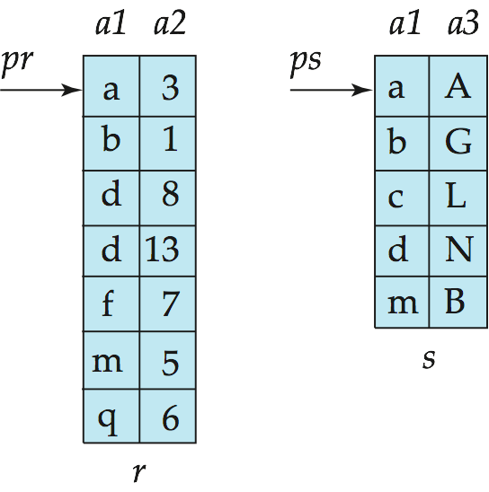
(4) Merge-Join (sort-merge join, 排序归并连接)
Sort both relations on their join attribute (if not already sorted on the join attributes).
Merge the sorted relations to join them
  Join step is similar to the merge stage of the sort-merge algorithm.
  Main difference is handling of duplicate values in join attribute — every pair with same value on join attribute must be matched
  Detailed algorithm in book
Lecture 10: Query Processing — Database System

Slide 44
Merge-Join (Cont.)
Can be used only for equi-joins and natural joins
Each block needs to be read only once (assuming all tuples for any given value of the join attributes fit in memory)
Thus the cost of merge join is:
b_{r} + b_{s} block transfers + ⎡b_{r} / b_{b}⎤ + ⎡b_{s} / b_{b}⎤ seeks
  + the cost of sorting if relations are unsorted.
Hybrid merge-join (混合归并连接) If one relation is sorted, and the other has a secondary B⁺-tree index on the join attribute
  Merge the sorted relation with the leaf entries of the B⁺-tree.
  Sort the result on the addresses of the unsorted relation’s tuples
  Scan the unsorted relation in physical address order and merge with previous result, to replace addresses by the actual tuples
    Sequential scan more efficient than random lookup
Lecture 10: Query Processing — Database System

Slide 45
(5) Hash-Join (哈希连接)
Applicable for equi-joins and natural joins.
A hash function h is used to partition tuples of both relations
h maps JoinAttrs values to {0, 1, ..., n}, where JoinAttrs denotes the common attributes of r and s used in the natural join.
  r₀, r₁, . . ., r_{n} denote partitions of r tuples
    Each tuple t_{r} ∈ r is put in partition r_{i} where i = h(t_{r} [JoinAttrs]).
  s₀, s₁ . . ., s_{n} denotes partitions of s tuples
    Each tuple t_{s} ∈s is put in partition s_{i}, where i = h(t_{s} [JoinAttrs]).
Note: In book, r_{i} is denoted as H_{ri,} s_{i} is denoted as H_{si} and
n is denoted as n_{h.}
Lecture 10: Query Processing — Database System

Slide 46
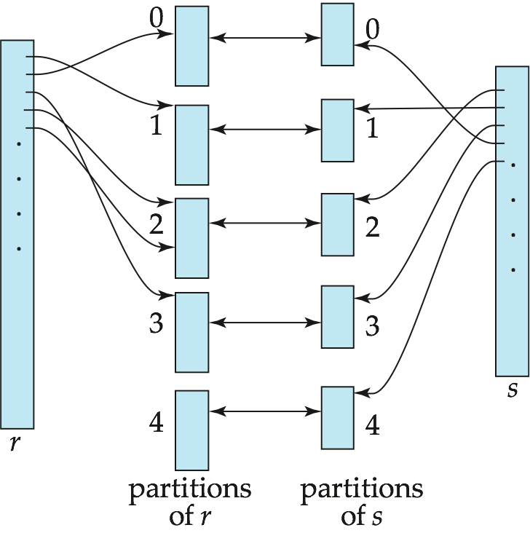
Hash-Join (Cont.)
Lecture 10: Query Processing — Database System

Slide 47
Hash-Join (Cont.)
r tuples in r_{i} need only to be compared with s tuples in s_{i} Need not be compared with s tuples in any other partition, since:
  An r tuple and an s tuple that satisfy the join condition will have the same value for the join attributes.
  If that value is hashed to some value i, the r tuple has to be in r_{i} and the s tuple in s_{i}.
Lecture 10: Query Processing — Database System

Slide 48
Hash-Join Algorithm
The hash-join of r and s is computed as follows.
1. Partition the relation s using hashing function h. When partitioning a relation, one block of memory is reserved as the output buffer for each partition.
2. Partition r similarly.
3. For each i:
  (a) Load s_{i} into memory and build an in-memory hash index on it using the join attribute. This hash index uses a different hash function than the earlier one h.
  (b) Read the tuples in r_{i} from the disk one by one. For each tuple t_{r} locate each matching tuple t_{s} in s_{i} using the in-memory hash index. Output the concatenation of their attributes.
Relation s is called the build input, and r is called the probe input.
Lecture 10: Query Processing — Database System

Slide 49
Hash-Join algorithm (Cont.)
The value n and the hash function h is chosen such that each s_{i} should fit in memory.
  Typically n is chosen as ⎡b_{s}/M⎤ * f where f is a “fudge factor”, typically around 1.2
  The probe relation partitions s_{i} need not fit in memory
Recursive partitioning required if the number of partitions n is greater than the number of pages M of memory.
  instead of partitioning n ways, use M – 1 partitions for s
  Further partition the M – 1 partitions using a different hash function
  Use same partitioning method on r
  Rarely required: e.g., with block size of 4 KB, recursive partitioning not needed for relations of < 1GB with memory size of 2MB, or relations of < 36 GB with memory of 12 MB
Lecture 10: Query Processing — Database System

Slide 50
*Handling of Overflows
Hash-table overflow occurs in partition Hs_{i} , if Hs_{i} does not fit in memory. Reasons could be
  Many tuples in s with same value for join attributes (分区不均匀)
  Bad hash function
Partitioning is said to be skewed(有偏的) if some partitions have significantly more tuples than some others.
Solutions:
  Typically n_{h} is chosen as ⎡b_{s}/M⎤ * f , where f is a “fudge factor”, typically around 1.2
  Overflow resolution(溢出分解) can be done in build phase
    Partition Hs_{i} is further partitioned using different hash function.
    Partition Hr_{i} must be similarly partitioned.
  Overflow avoidance (溢出避免) performs partitioning carefully to avoid overflows during build phase
    E.g., partition build relation into many partitions, then combine them
  If both approaches fail with large numbers of duplicates
    Fallback option: use block nested loops join on overflowed
Lecture 10: Query Processing — Database System

Slide 51
Cost of Hash-Join
If recursive partitioning is not required: cost of hash join is
3(b_{r} + b_{s}) +4 ∗ n_{h} block transfers +
2( ⎡b_{r} / b_{b}⎤ + ⎡b_{s} / b_{b}⎤) + 2 n_{h} seeks
If recursive partitioning required:
  number of passes required for partitioning build relation
  s is ⎡log_{M–1}(b_{s}) – 1⎤
  best to choose the smaller relation as the build relation.
  Total cost estimate is:
  2(b_{r} + b_{s}) ⎡log_{M–1}(b_{s}) – 1⎤ + b_{r} + b_{s} block transfers +
  2(⎡b_{r} / b_{b}⎤ + ⎡b_{s} / b_{b}⎤) ⎡log_{M–1}(b_{s}) – 1⎤ seeks
If the entire build input can be kept in main memory no partitioning is required
  Cost estimate goes down to b_{r} + b_{s}. – best case
Lecture 10: Query Processing — Database System

Slide 52
Example of Cost of Hash-Join
instructor teaches
Assume that memory size is 20 blocks
b_{instructor}= 100 and b_{teaches} = 400.
instructor is to be used as build input. Partition it into five partitions, each of size 20 blocks. This partitioning can be done in one pass.
Similarly, partition teaches into five partitions,each of size 80. This is also done in one pass.
Therefore total cost, ignoring cost of writing partially filled blocks:
  3(100 + 400) = 1500 block transfers +
  2( ⎡100/3⎤ + ⎡400/3⎤) = 336 seeks
Lecture 10: Query Processing — Database System

Slide 53

* Hybrid Hash–Join
Useful when memory sized are relatively large, and the build input is bigger than memory.
Main feature of hybrid hash join:
Keep the first partition of the build relation in memory.
E.g., With memory size of 25 blocks, instructor can be partitioned into five partitions, each of size 20 blocks.
  Division of memory:
    The first partition occupies 20 blocks of memory
    1 block is used for input, and 1 block each for buffering the other 4 partitions.
teaches is similarly partitioned into five partitions each of size 80
  the first is used right away for probing, instead of being written out
Cost of 3(80 + 320) + 20 +80 = 1300 block transfers for
hybrid hash join, instead of 1500 with plain hash-join.
Hybrid hash-join most useful if M >>
Lecture 10: Query Processing — Database System

Slide 54
(6) Complex Joins
Join with a conjunctive condition:
r _{θ1∧ θ 2∧... ∧ θ n} s
  Either use nested loops/block nested loops, or
  Compute the result of one of the simpler joins r _{θi} s
    final result comprises those tuples in the intermediate result that satisfy the remaining conditions
  θ₁ ∧ . . . ∧ θ_{i –1} ∧ θ_{i +1} ∧ . . . ∧ θ_{n}
Join with a disjunctive condition
  r _{θ1 ∨ θ2 ∨... ∨ θn} s
  Either use nested loops/block nested loops, or
  Compute as the union of the records in individual joins r _{θ i} s:
  (r _{θ1} s) ∪ (r _{θ2} s) ∪ . . . ∪ (r _{θn} s)
Lecture 10: Query Processing — Database System

Slide 55
Outline
Overview
Measures of Query Cost
Selection Operation
*Sorting
Join Operation
*Other Operations
*Evaluation of Expressions
Lecture 10: Query Processing — Database System

Slide 56
*Other Operations
Duplicate elimination can be implemented via hashing or sorting.
  On sorting duplicates will come adjacent to each other, and all but one set of duplicates can be deleted.
  Optimization: duplicates can be deleted during run generation as well as at intermediate merge steps in external sort-merge.
  Hashing is similar – duplicates will come into the same bucket.
Projection:
  Perform projection on each tuple
  Followed by duplicate elimination.
Lecture 10: Query Processing — Database System

Slide 57
Other Operations: Aggregation
Aggregation can be implemented in a manner similar to duplicate elimination.
  Sorting or hashing can be used to bring tuples in the same group together, and then the aggregate functions can be applied on each group.
  Optimization: combine tuples in the same group during run generation and intermediate merges, by computing partial aggregate values
    For count, min, max, sum: keep aggregate values on tuples found so far in the group.
      When combining partial aggregate for count, add up the aggregates
    For avg, keep sum and count, and divide sum by count at the end
Lecture 10: Query Processing — Database System

Slide 58
Other Operations : Set Operations
Set operations (∪, ∩ and －): can either use variant of merge-join after sorting, or variant of hash-join.
E.g., Set operations using hashing:
  1. Partition both relations using the same hash function, thereby creating, r_{1, ..,} r_{n} r_{0,} and s_{1,} s_{2..,} s_{n}
  2. Process each partition i as follows. Using a different hashing function, build an in-memory hash index on r_{i} after it is brought into memory.
  3. (1) r ∪ s: Add tuples in s_{i} to the hash index if they are not already in it. At end of s_{i} add the tuples in the hash index to the result.
  (2) r ∩ s: output tuples in s_{i} to the result if they are already there in the hash index.
  (3) r – s: for each tuple in s_{i}, if it is there in the hash index, delete it from the index. At end of s_{i} add remaining tuples in the hash index to the result.
Lecture 10: Query Processing — Database System

Slide 59
Other Operations: Outer Join
Outer join can be computed either as
  A join followed by addition of null-padded non-participating tuples.
  by modifying the join algorithms.
Modifying merge join to compute r s
  In r s, non participating tuples are those in r – Π_{R}(r s)
  Modify merge-join to compute r s: During merging, for every tuple t_{r} from r that do not match any tuple in s, output t_{r} padded with nulls.
  Right outer-join and full outer-join can be computed similarly.
Modifying hash join to compute r s
  If r is probe relation, output non-matching r tuples padded with nulls
  If r is build relation, when probing keep track of which
  r tuples matched s tuples. At end of s_{i} output
  non-matched r tuples padded with nulls
Lecture 10: Query Processing — Database System

Slide 60
Outline
Overview
Measures of Query Cost
Selection Operation
*Sorting
Join Operation
*Other Operations
*Evaluation of Expressions
Lecture 10: Query Processing — Database System

Slide 61
Evaluation of Expressions
So far: we have seen algorithms for individual operations. Now consider multi operations.
  ∏_{customer-name} ((σ_{balance<2500}(account )) depositor)
Alternatives for evaluating an entire expression tree
  Materialization(实体化): generate the results of an expression, and store the results to disk.
  Pipelining (流水线) : pass on tuples to parent operations even as an operation is being executed
We study above alternatives in more detail
Lecture 10: Query Processing — Database System

Slide 62

(1) Materialization
Materialized evaluation: evaluate one operation at a time, starting at the lowest-level. Use intermediate results materialized into temporary relations to evaluate next-level operations.
E.g., in figure below, compute and store
then get back the stored result and join with depositor, and finally compute the projections on customer-name.
temp
temp
depositor
Lecture 10: Query Processing — Database System

Slide 63
Materialization (Cont.)
Materialized evaluation is always applicable
Cost of writing results to disk and reading them back can be quite expensive.
  Our cost formulas for operations ignore cost of writing results to disk, so
    Overall cost = Sum of costs of individual operations +
    cost of writing intermediate results to disk
(改进) Double buffering: use two output buffers for each operation, when one is full write it to disk while the other is getting filled
  Allows overlap of disk writes with computation and reduces execution time
Lecture 10: Query Processing — Database System

Slide 64
(2) Pipelining
Pipelined evaluation: evaluate several operations simultaneously, passing the results of one operation on to the next.
E.g., in previous expression tree, don’t store result of
instead, pass tuples directly to the join. Similarly, don’t store result of join, pass tuples directly to projection.
depositor
Lecture 10: Query Processing — Database System

Slide 65
(2) Pipelining (cont.)
Much cheaper than materialization: no need to store a temporary relation to disk.
Pipelining may not always be possible. (depend on the type of next operations, and whether the output is sorted, etc.)
For pipelining to be effective, use evaluation algorithms that generate output tuples even as tuples are received for inputs to the next operation.
Pipelines can be executed in two ways: demand driven and producer driven
（需求驱动流水线、生产者驱动流水线）
由上而下吸引
由下而上的推动
Lecture 10: Query Processing — Database System

Slide 66
*Pipelining (Cont.)
In demand driven or lazy evaluation
  System repeatedly requests next tuple from top level operation
  Each operation requests next tuple from children operations as required, in order to output its next tuple
  In between calls, operation has to maintain “state” so it knows what to return next
  Each operation is implemented as an iterator (迭代器) implementing the following operations
Lecture 10: Query Processing — Database System

Slide 67
*Pipelining (Cont.)
Open()
  E.g., file scan: initialize file scan, store pointer to beginning of file as state
  E.g., merge join: sort relations and store pointers to beginning of sorted relations as state
Next()
  E.g., for file scan: output next tuple, and advance and store file pointer
  E.g., for merge join: continue with merge from earlier state till next output tuple is found. Save pointers as iterator state.
Close()
Lecture 10: Query Processing — Database System

Slide 68
*Pipeline (Cont.)
In produce-driven or eager pipelining
  Operators produce tuples eagerly and pass them up to their parents
    Buffer maintained between operators, child puts tuples in buffer, parent removes tuples from buffer
    If buffer is full, child waits till there is space in the buffer, and then generates more tuples
  Systems schedules operations that have space in output buffer and can process more input tuples
Lecture 10: Query Processing — Database System

Slide 69
*Evaluation Algorithms for Pipelining
Some algorithms are not able to output results even as they get input tuples
  E.g. merge join, or hash join
  These results in intermediate results being written to disk and then read back always
Algorithm variants are possible to generate(at least some) results on the fly, as input tuples are read in
Lecture 10: Query Processing — Database System

Slide 70
*Evaluation Algorithms for Pipelining
Some algorithms are not able to output results even as they get input tuples
  E.g. merge join, or hash join
  These results in intermediate results being written to disk and then read back always
Algorithm variants are possible to generate(at least some) results on the fly, as input tuples are read in
  E.g. hybrid hash join generates output tuples even as probe relation tuples in the in-memory partition (partition 0) are read in
  Double-pipelined join technique: Hybrid hash join, modified to buffer partition 0 tuples of both relations in-memory, reading them as they become available, and output results of any matches between partition 0 tuples
    When a new r₀ tuple is found, match it with existing s₀ tuples, output matches, and save it in r₀
    Symmetrically for s₀ tuples
Lecture 10: Query Processing — Database System

Slide 71
*Complex Joins
Join involving three relations: loan depositor customer
Strategy 1. Compute depositor customer; use result to compute loan (depositor customer)
Strategy 2. Computer loan depositor first, and then join the result with customer.
Strategy 3. Perform the pair of joins at once. Build and index on loan for loan-number, and on customer for customer-name.
  For each tuple t in depositor, look up the corresponding tuples in customer and the corresponding tuples in loan.
  Each tuple of deposit is examined exactly once.
Strategy 3 combines two operations into one special-purpose operation that is more efficient than implementing two joins of two relations.
Lecture 10: Query Processing — Database System

Slide 72
Example
Given tables:
T1(bno, type, title, press, year);
T2(id, bno, date1, date2); // bno is foreign key referencing T1
T1 has 20,000 tuples, T2 has 45,000 tuples. 25 tuples of T1 fit in one block, 30 tuples of T2 fit in one block.
T1 has a primary B+-tree index on primary key attribute bno, which contains maximal 60 entries in each index node(I.t. n=60). Assume the allowed memory is in worst case. Compute the cost of the join operation for T1 and T2:
(1) Block nested-loop join
(2) index nested-loop join
b₁=20000/25=800, b₂= 45000/30=1500, log_{60/2} 20000 ≈ 3
(1) BT costs =800 x 1500 + 800 =1200800, seeks =2*1500
(2) BT costs =45000 x (3 +1 ) + 1500 = 18150, seeks=18150 (T2 is outer, T1 is inner relation.)
Lecture 10: Query Processing — Database System

Slide 73

Q & A
Your questions and suggestions are expected for me.
Thanks a lot!
Exercises: 15.2, 15.3, 15. 6, and 15.20 (see Pages 736-739)
Questions?
Lecture 10: Query Processing — Database System

